Slide 1
Introduction to Computational Chemistry
Dr Molly Bartlett

Slide 2
Contents
Molecule generation
SMILES
RDKit
Exporting molecules
Calculation descriptors
Modelling
DFT (quantum mechanics)
xTB (semi-empirical)

Slide 3
Prerequisites
Install python using conda
Install RDKit onto conda environment
Jupyter notebooks
Download files from github:
Notes:
RDKit guide: https://www.rdkit.org/docs/GettingStartedInPython.html
Conda install guide: https://docs.conda.io/projects/conda/en/latest/user-guide/install/index.html
Jupyter notebooks guide: https://jupyter-notebook.readthedocs.io/en/latest/?badge=latest
Github: XXXX

Slide 4
Molecule generation

Slide 5
RDKit
RDKit is a cheminformatics python package for cheminformatics
It is used to generate computational representations of molecules
RDKit molecules can be converted to 3D and undergo geometry optimisation
The optimised molecules can be exported as input files for DFT and docking
RDKit can also calculate various molecular properties (e.g molecular weight, total polar surface area, moments of inertia)
Molecules can be imported into RDKit from SMILES string or .mol/.sdf files

Slide 6
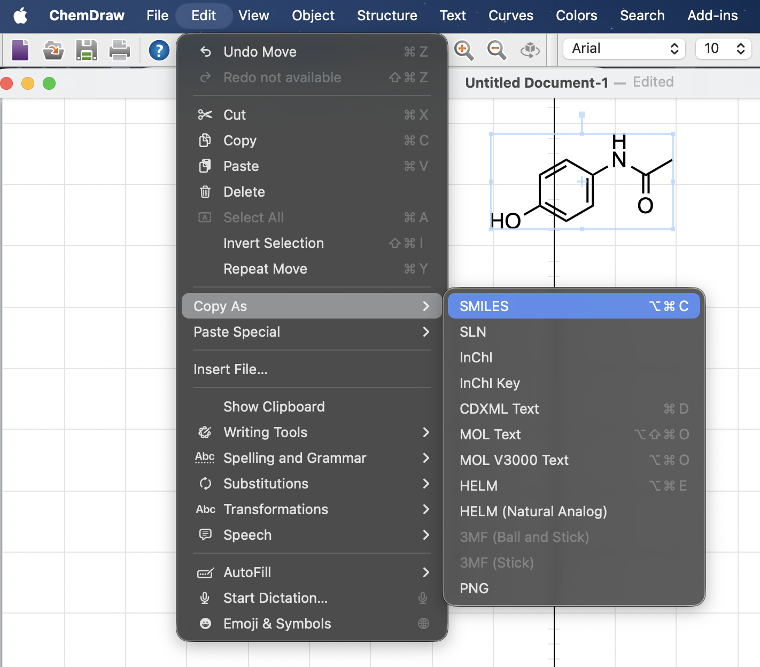
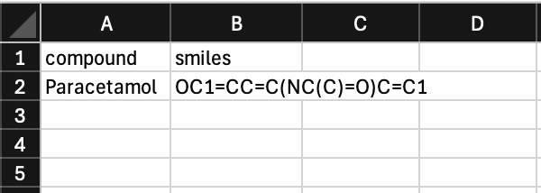
SMILES
Obtained using ChemDraw and copying as SMILES
Simplified Molecular Input Line Entry System
Representation of molecules as text
Paracetamol
OC1=CC=C(NC(C)=O)C=C1
Save to a .csv file:

Slide 7
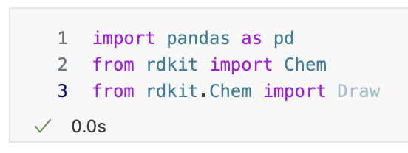
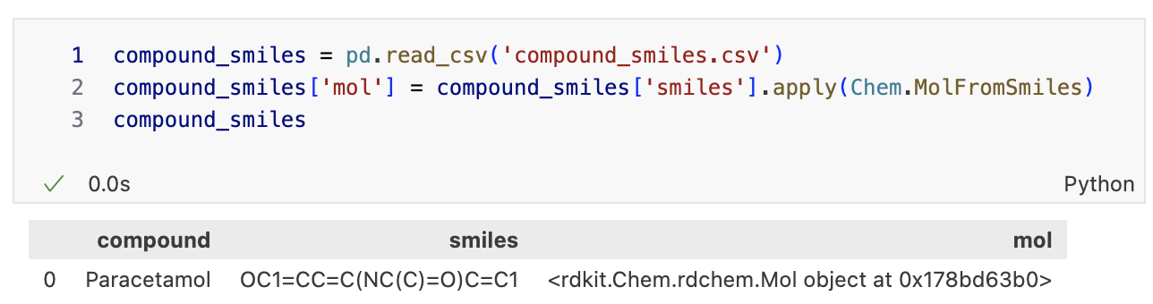
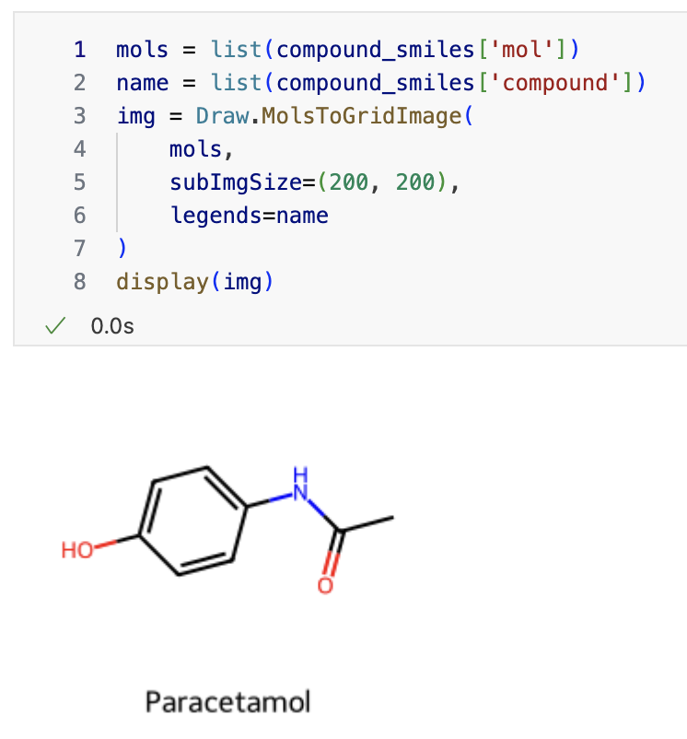
RDKit
See content files:
Jupyter notebook: comp_chem_intro.ipynb
csv file: compound_smiles.csv
Import packages and molecules csv into notebook
Create rdkit object from SMILES gives 2D structure
3) Visualise imported compounds

Slide 8
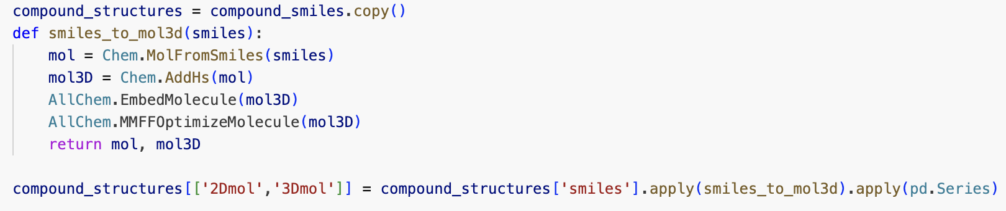
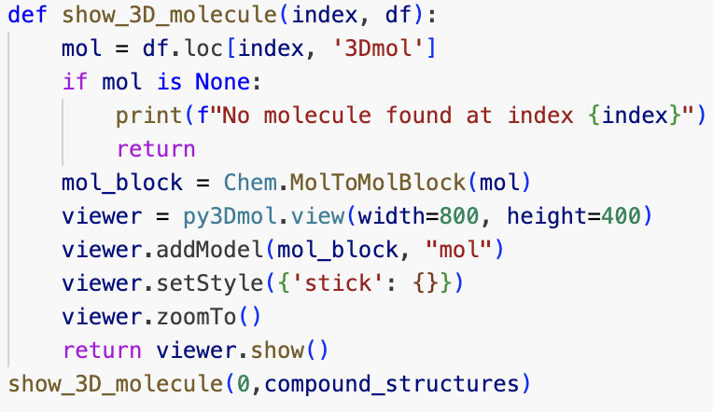
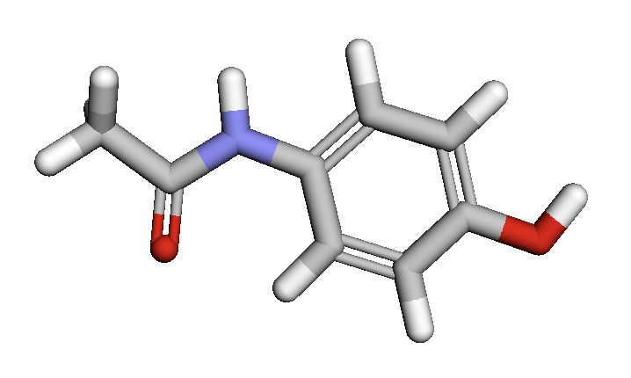
RDKit: 3D molecule generation
3D structures can be produced from SMILES using the function below
The Pymol toolkit enables visualisation of the 3D molecules (install pymol on conda)

Slide 9
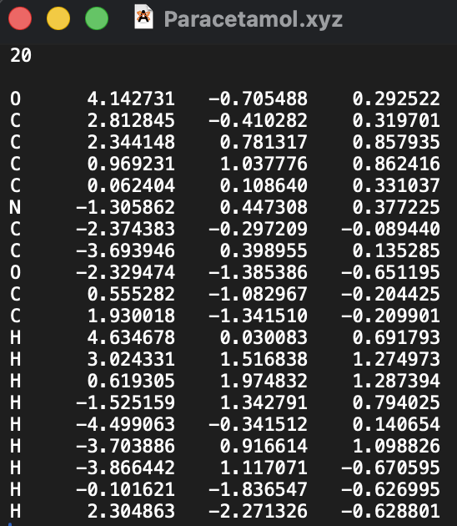
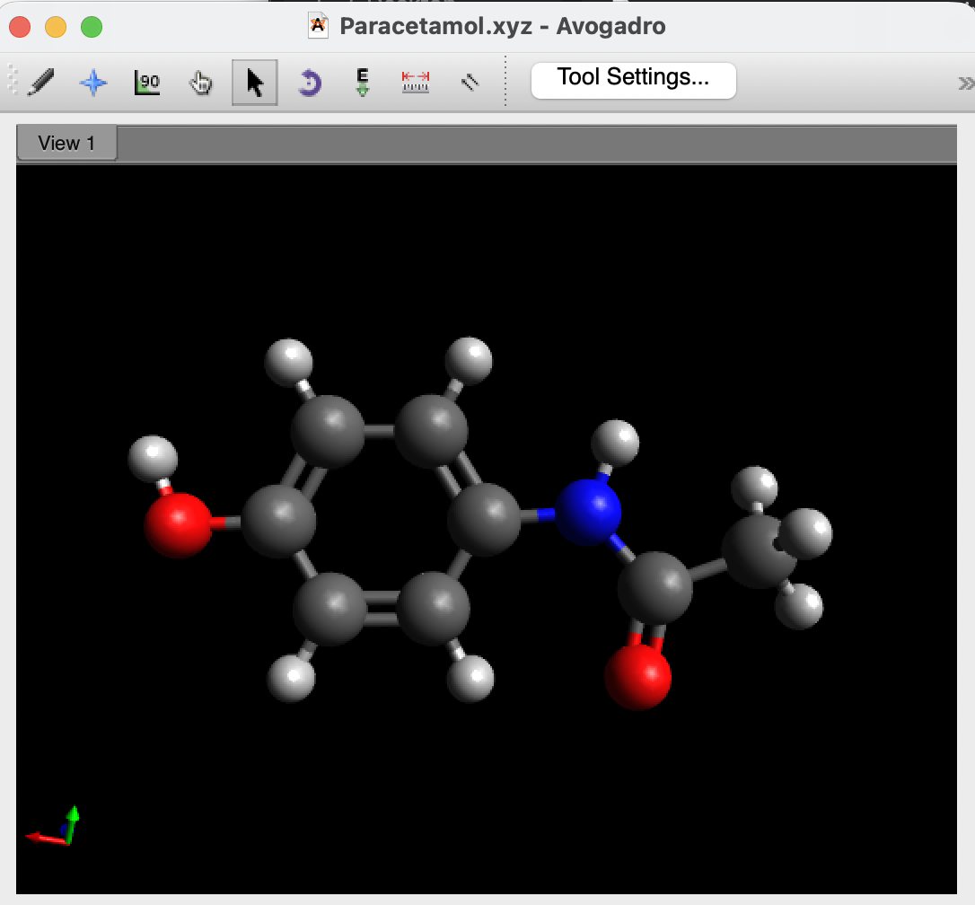
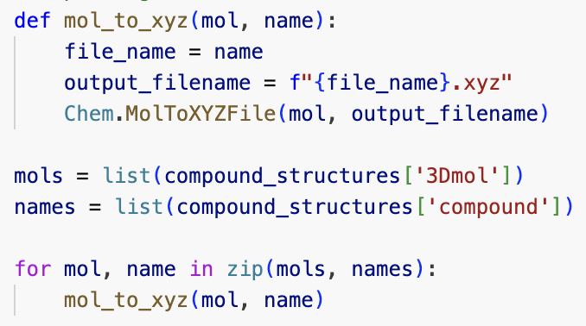
Exporting molecules

Slide 10
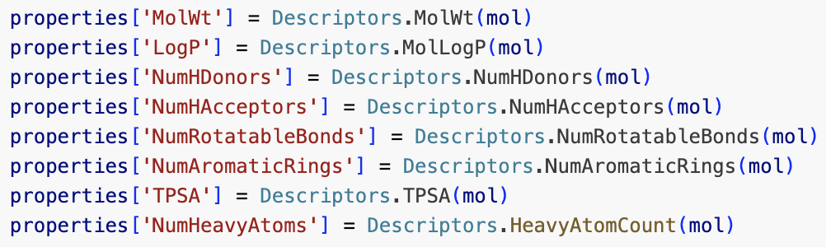
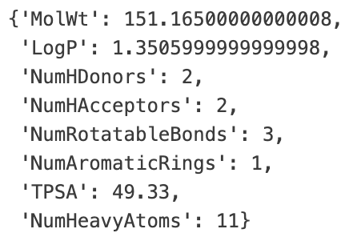

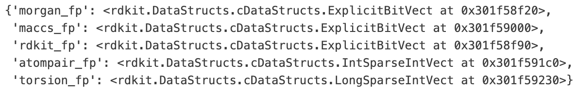


Calculating properties and descriptors
Rdkit can be used to calculate properties (e.g MW, total polar surface area) and molecular descriptors (mordred, fingerprints, graphs)
Descriptors can be used to represent molecules to machine learning models
Notes:
Rdkit descriptors: https://www.rdkit.org/docs/GettingStartedInPython.html#list-of-available-descriptors
Mordred descriptors: https://mordred-descriptor.github.io/documentation/master/introduction.html

Slide 11
Modelling

Slide 12
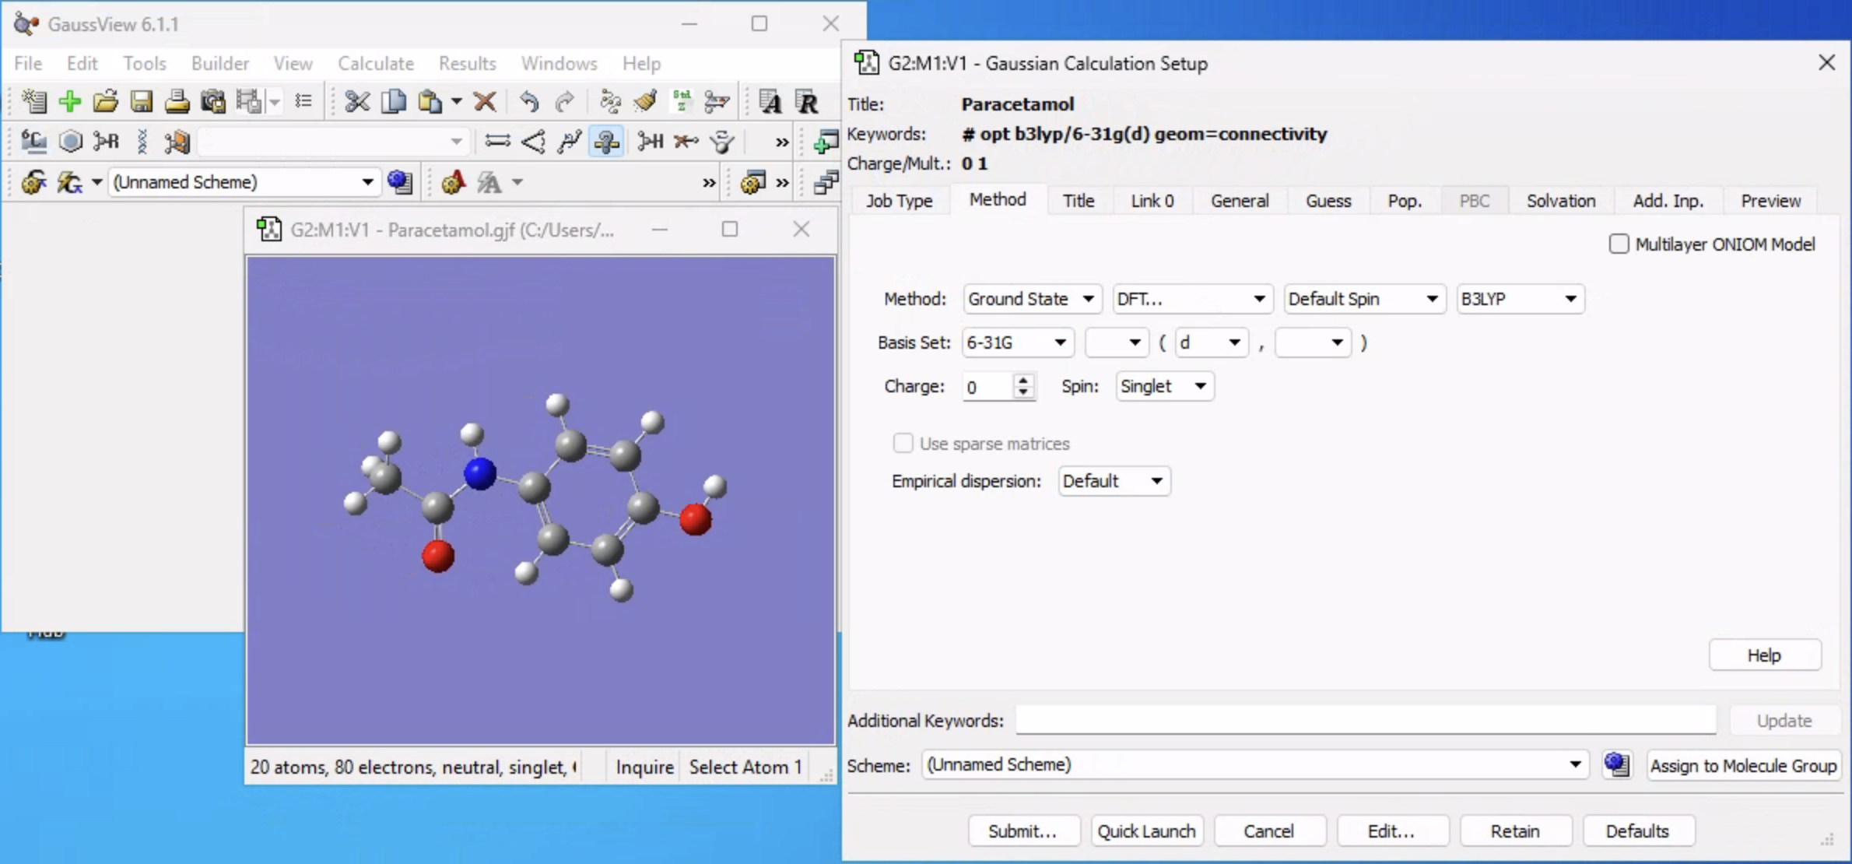
Density Functional Theory (DFT)
DFT is a quantum mechanical method for calculating molecular properties such as ground state geometry, energy and electron structure
Inputs define keywords argument:
Job type: Geometry optimisation, energy
Method: DFT, semi-empirical
Functional: B3LYP
Basis set: 6-31G(d)
Notes:
Gaussian16 can be downloaded from software hub: https://softwarehub.imperial.ac.uk/login
Non-terminal HPC Gaussian submission https://openondemand.rcs.ic.ac.uk/pun/sys/dashboard
Access via Jobs → CHAMP

Slide 13
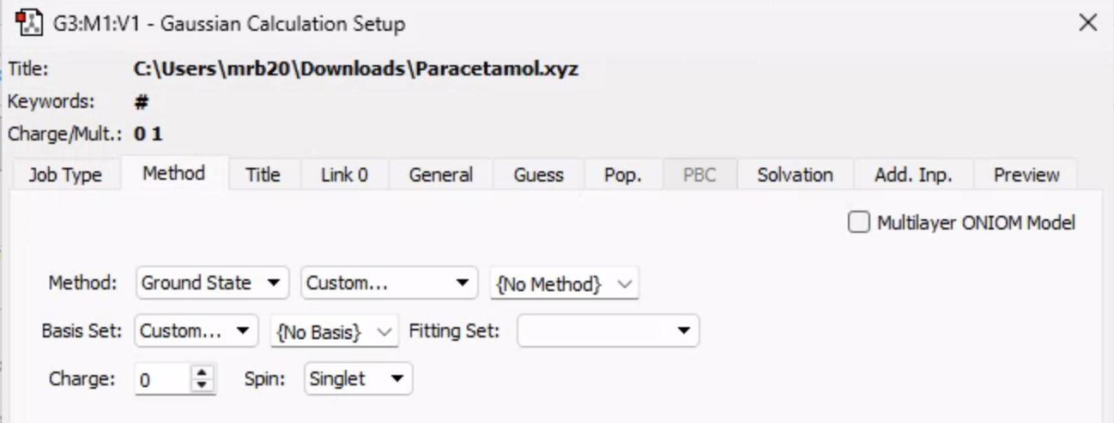
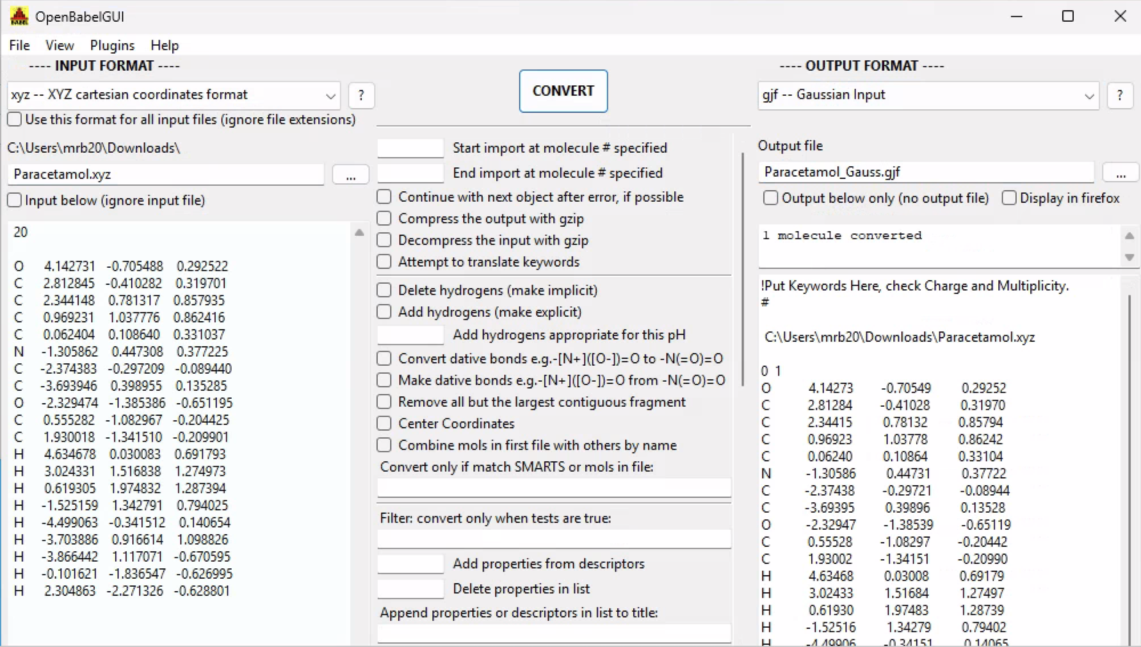
Open Babel
Simple file conversion software
Can convert a .xyz file to a blank gaussian input file (.gjf) to set up the calculation using GaussView
Notes:
Open Babel can be downloaded from software hub: https://softwarehub.imperial.ac.uk/login

Slide 14
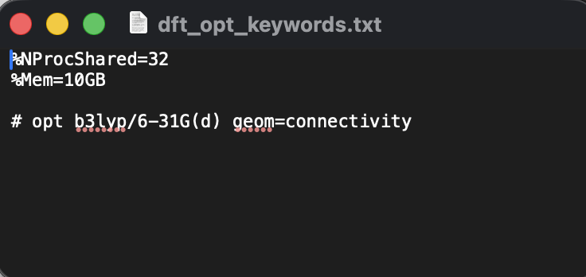
Automated gaussian file generation
DFT jobs are defined using keywords in a .txt file:
Job size: NProcShared=32, Mem=10GB (use 32 CPU cores and 10GB memory)
Job type: geometry optimisation (opt)
Functional (B3LYP) and basis set (6-31G(d))
Defined molecule source (atom coordinates): geom=connectivity

Slide 15
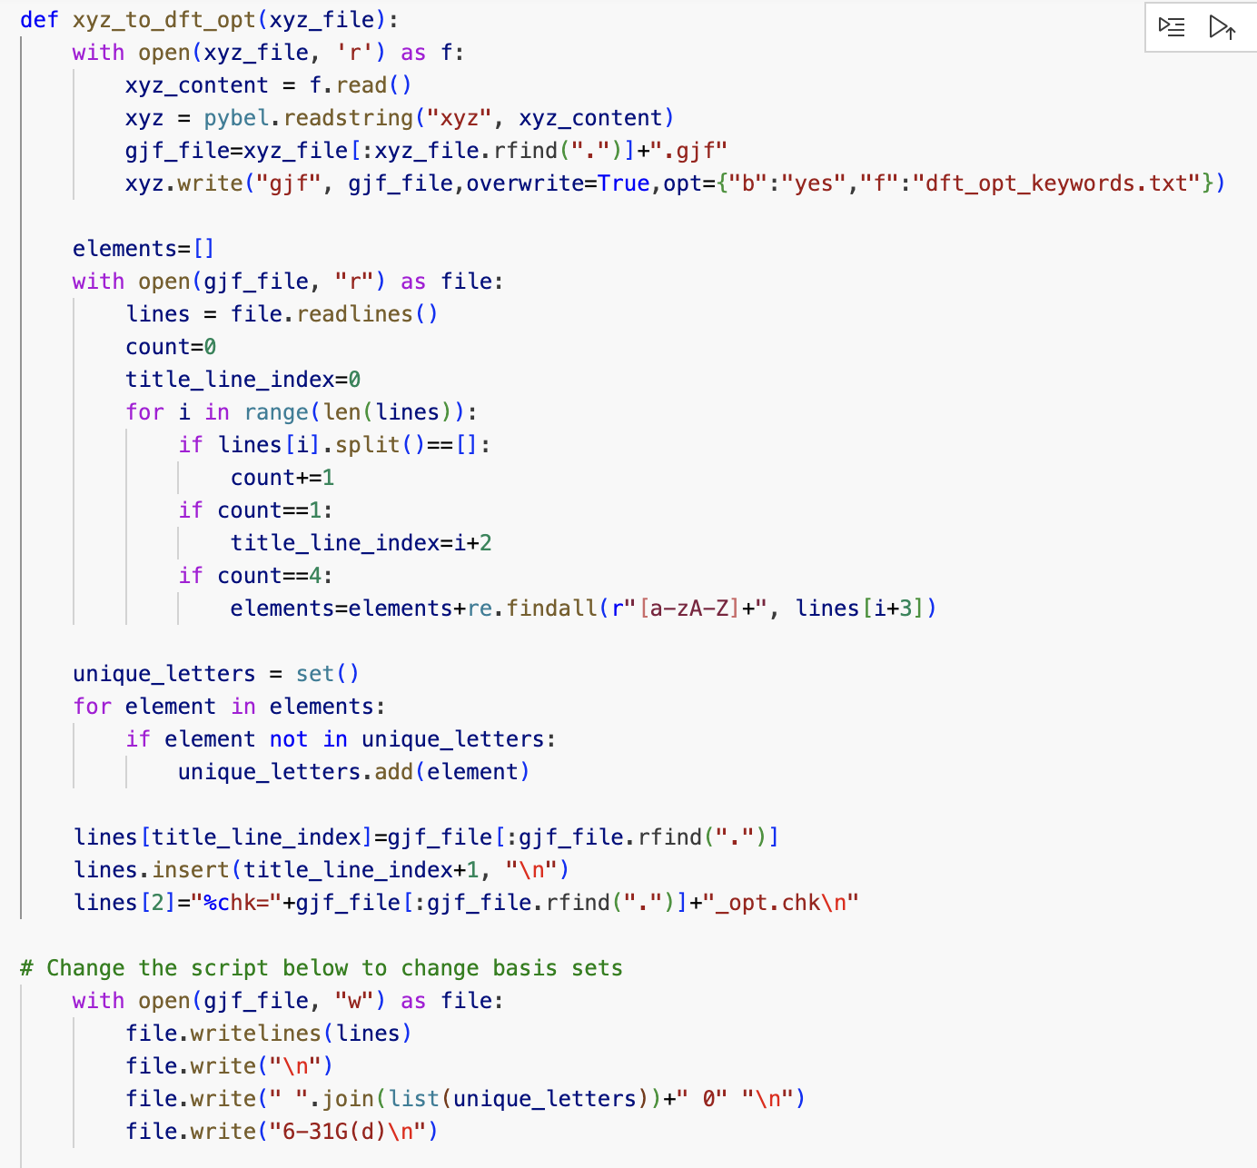
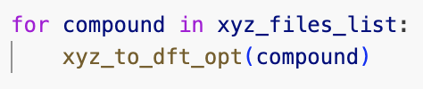
Gaussian input generation
Script extracts text from xyz file
Inserts the coordinate string extracted from the xyz file (lines)
Define job in dft_opt_keywords.txt
Define basis sets in file.write
Text then saved as compound.gjf

Slide 16
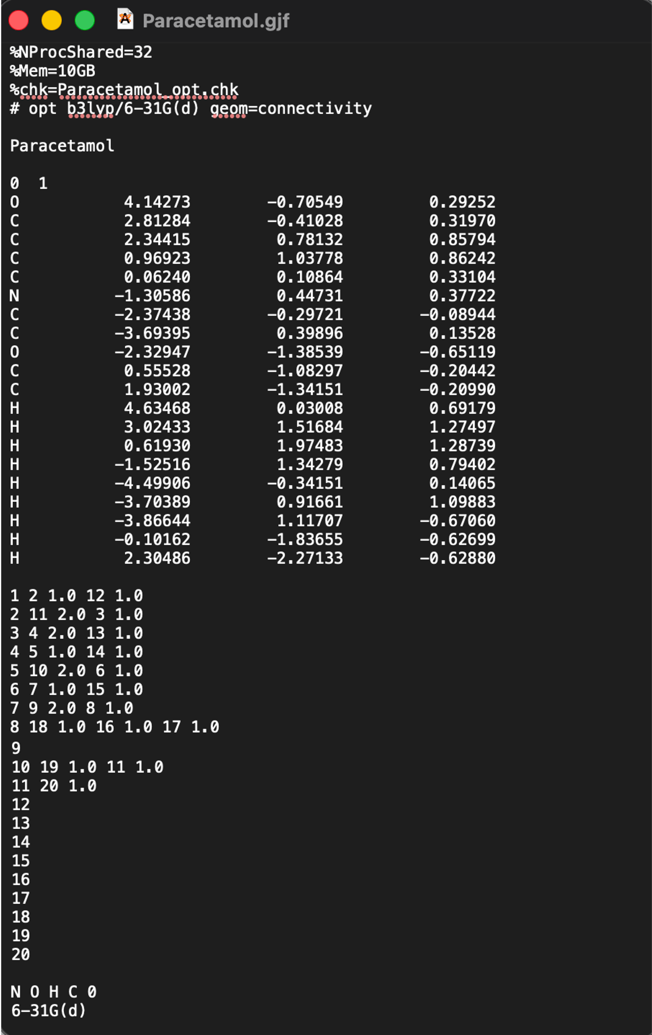
Gaussian input generation output
This file can now be opened in Gaussian or uploaded to CHAMP, or the HPC for calculations
Notes:
Non-terminal HPC Gaussian submission https://openondemand.rcs.ic.ac.uk/pun/sys/dashboard
Access via Jobs → CHAMP

Slide 17
Gaussian multi-job submission (HPC)
Wilson Wu’s batch submission HPC script: https://github.com/VilarResearchGroup/batch_qsub_gaussian
Upload your gjf files to the HPC and run Wilson’s script to submit up to 50 jobs at a time in batch
Non-terminal HPC Gaussian submission: https://openondemand.rcs.ic.ac.uk/pun/sys/dashboard
Access via: Jobs → CHAMP
Upload .gjf file

Slide 18
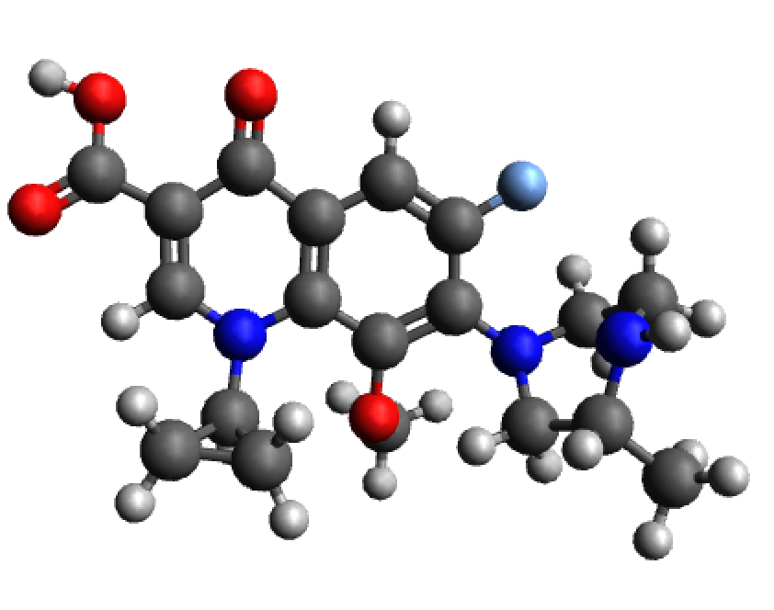
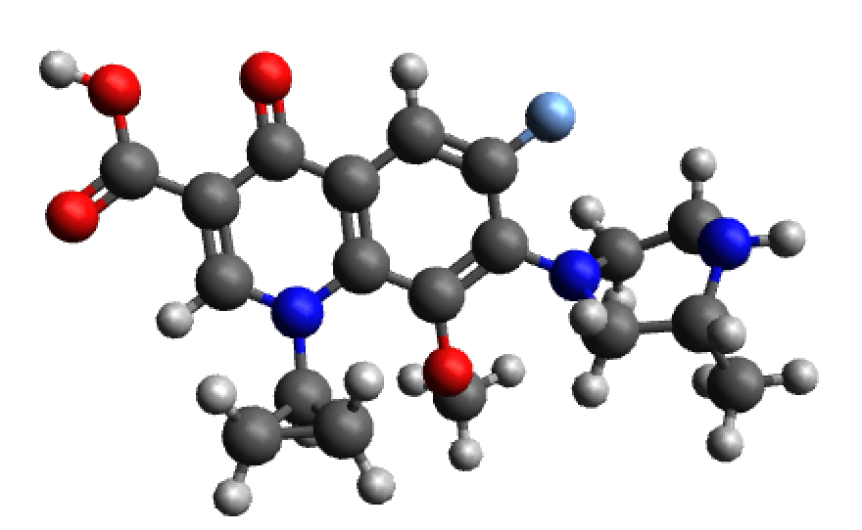

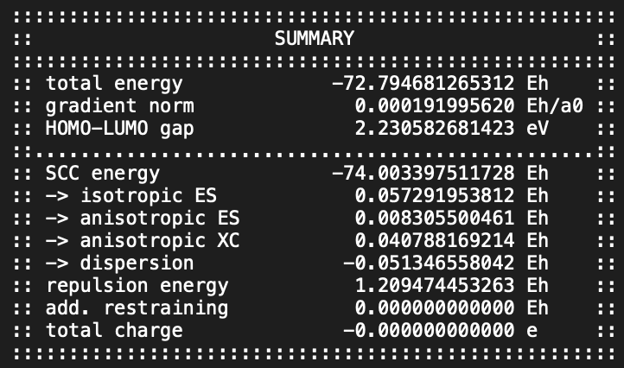
xTB: semi-empirical eXtended Tight Binding
Semi-empirical quantum mechanical (SQM) method
SQM: use of theoretical physics + parameters defined using probabilities from experimental data
Uses simplified mathematical descriptions (minimal basis sets) for valence electrons
Simplified electron interactions with tight binding approximations on core electrons
Includes corrections to account for electrostatic interactions and exchange correlation effects
As a result, xTB provides a balance of speed and accuracy for geometry optimisation and energy calculations
xTB optimisation and single point energy calculation
QM energy properties
Force field only optimised conformer
Optimised conformer geometry
+
Notes:
xTB guide: https://xtb-docs.readthedocs.io/en/latest/setup.html

Slide 19
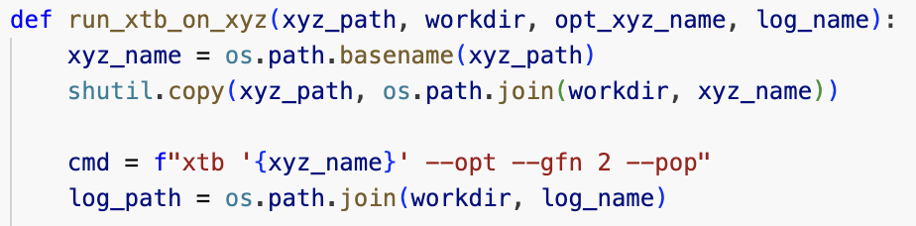
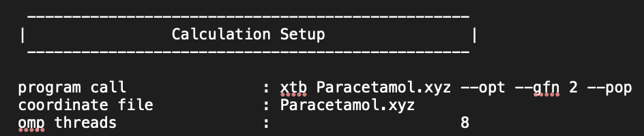
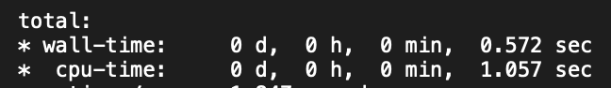
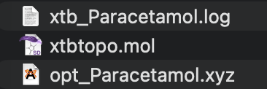
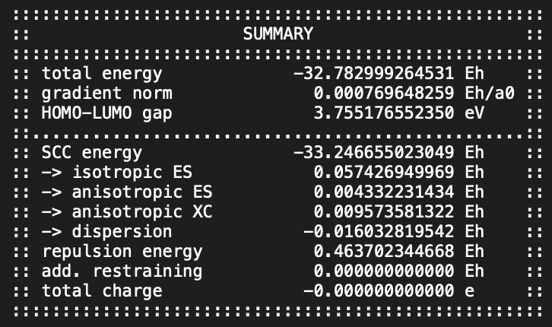
xTB
xTB runs in under a second compared to DFT which can take multiple hours
The outputs include optimises .mol file and .xyz file
QM properties can be extracted from the log file:

